Slide 1

Improving Revenue, Customer Satisfaction, and Company Expansion
Ellie Goodman
Notes:
Need date & picture

Slide 2
Table of Contents
Executive Summary..................................................................................................3
Impacting Netflix's Revenue.................................................................................5-8
Impacts on Branding Strategy.………………………………………………....10-11
Job Creation and Impact on Company Culture..................................................13-16
Creating Value for the Consumer…...................................................................18-21
Impacts of an Acquisition on Target Market…..................................................23-24
Conclusion..............................................................................................................25
Attribution Slide.....................................................................................................26
References..........................................................................................................27-31

Slide 3
Executive Summary
Netflix started off as the sole provider for streaming services, and since then many other companies wanted to gain shares in this market. A recent survey found that, over the last five years, 83% of individuals were using a streaming service, and this was a growth of 20 percent (Statista). Current business models of Netflix have led to a major decline in subscriber counts due to rising subscription prices, more streaming competition, and slow economic growth. Many individuals in the US are switching to streaming services over cable, so Netflix should be thriving, but in 2020 Disney+ came onto the scene, and started the streaming service wars. With more options for streaming arising, Netflix has the opportunity to diversify its portfolio to introduce a unique consumer experience by acquiring Spotify.
If Netflix acquires Spotify, they would be able to diversify their portfolio and hedge against potential loss of revenue by expanding their industry outreach, creating customer satisfaction, broadening their market share, thus leading to revenue increase.
1
Acquiring Spotify diversifies revenue streams
The collaboration of Spotify and Netflix will diversify Netflix's revenue streams by co-branding two of the most popular streaming services in the industry. Netflix and Spotify lead the streaming industry by remaining the top music and video streaming services. The collaboration of Spotify will provide a new source of revenue by incorporating podcasts, a different form of entertainment unique to Spotify. Spotify will also help expand Netflix's promotion strategies in the streaming industry by collaborating with influencers/companies who promote the brand. The collaboration of companies will grow international horizons as it expands into different cultures.
3
The accession of Spotify allows for a more inclusive branding strategy
Spotify and Netflix’s similar branding strategies will make for a seamless transition into one marketing team. Using Spotify’s influencer and brand partnership background, Netflix will be able to expand their promotional opportunities.
4
The addition of Spotify increases consumer value and satisfaction
Customer satisfaction will increase due to this acquisition because Netflix will appeal more to consumers with Spotify in its portfolio. It can do this through better personalization analytics, expanding into a wider variety of industries, and lowering prices for consumers through promotional deals and service bundles. When the customer sees value, they are more likely to pay for subscriptions.
2
Merging company cultures increases job opportunities and employee satisfaction
Bringing Netflix and Spotify's companies together promotes industry expansion by creating job opportunities, more diversity, and better work culture for the company. Netflix and Spotify both are at the top of its own industry by holding top leadership positions in the video and music category. Both companies focus heavily on diversity and inclusion to make sure everyone's voice is heard, gaining respect from their customers. This similarity will ensure a smooth integration of the company's management styles and culture. The acquiring of Spotify can place Netflix in a great position for adding jobs in technology and content creation field.
5
Combining industry resources produces a dominant market share
The collaboration in Netflix and Spotify's market shares, they will dominate the entertainment industry. Spotify, being the number one audio streaming service, has many subscribers in Europe and caters to a younger generation. Netflix, on the other hand, is the number one video streaming service. Netflix has over a third of its subscribers in the United States & Canada and overall serves an older crowd. The difference in the demographics of the two companies will be a positive aspect in the acquisition, in order to grow Netflix's consumer base.
Ultimately, adding Spotify to Netflix's business operations will create a unique experience for consumers. In addition, the two companies' collaboration will result in diversified revenue streams, expansion in the streaming industry, customer satisfaction, and a dominant market share.

Slide 4
Internal: Impacting Netflix's Revenue

Slide 5
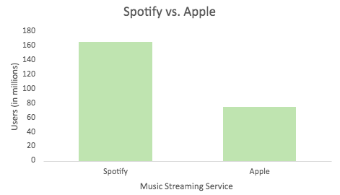
Spotify's popular podcasts will provide a new source of revenue for Netflix
The steady rise of podcasts in the streaming industry is a great way to build connections with consumers, bring another form of entertainment to choose from, and increase company revenue.
Podcast Popularity
The popularity of podcasts has skyrocketed over the past few decades. Over 20% of all internet users worldwide listen to podcasts, which is just a little over 424 million people (Lin, 2021). Podcasts have gained a reputation of independence, which is why they are continuously growing within the streaming industry, specifically Spotify, where most podcast users are found. Podcast users can listen without needing to watch anything, which allows them to be able to multitask - all while listening to their subject of choice. There are many appealing aspects with the rise of podcasts like their ability to connect with their listeners as there’s an infinite number of options to listen to, catering to a wide target audience of people with different interests. The addition of podcasts also help increase brand authority and build a larger fanbase, giving more brand recognition and security for a company (Digital Resource, 2021).
Podcasts within Netflix
With podcast users increasing by millions each month, numbers will have skyrocketed by 2023. With Spotify being the leader of podcast users in all streaming services, it has battled with other companies in the streaming industry’s competitive market. Specifically, Spotify has over 165 million subscribers compared to their biggest rival, Apple, with 75 million subscribers (Tateossian, 2022). Podcasts are a simple, yet effective way to connect with consumers, and increase subscribers and revenue. Because Netflix has a vast content base containing both informational and entertaining media, the addition of the latest trend, podcasts, will help reach and retain attention from its target audiences. In fact, "people are more and more interested in learning about new things through listening to audio content, which they can access everywhere at any time" (Tateossian, 2022). Netflix's addition of podcasts will be big, bright, and prove to be an effective marketing strategy and tool for many other popular companies, especially in the streaming industry.
With the attractiveness of podcasts and their continuous rise of popularity, podcasts are the newest hit. With Spotify being the number one leader of podcast users, they have a specific guide of trends happening in the streaming service industry. Partnering with Spotify, will help Netflix increase its entertainment options, attract a larger target market, and provide a new source of revenue.
Notes:
Visual on this slide showing the popularity of podcasts?
size 14 and visual
Podcast popularity is continuously growing. W
better than its original sources of entertainment.
Not only will the availability of podcasts bring a different source of new revenue for Netflix, but it will also bring another entertainment option, attracting a larger target market.

Slide 6
Spotify will increase Netflix's marketing strategy in the streaming industry because of its strategic advertising, brand uniqueness, and heavy social media presence
Spotify's strategical advertisement efforts, app uniqueness, and heavy social media presence make its promotion strategies strong which keeps them on top compared to competitors.
Advertising
Although subscribers using Spotify for free have frequent ads while on the app, Spotify has carefully crafted what these ads are about, and which companies and people promote them. Spotify's advertisements provide 9% of its total revenues (Davis, 2022). These advertisements can be anything between standard radio ads, video ads, sponsored playlists, and even ad takeovers. With different subscription types to choose from; Spotify's premium subscription, around $10 a month, provides users with an ad-free experience. Because advertisements may be inconvenient or frustrating to many, Spotify's premium subscription users equal a little over 90% of total revenue each year (Davis, 2022). The other 10% of Spotify users do experience ads, but in a unique way. In fact, "Spotify has recognized its potential for marketing success and has a well-organized advertising market" (Geyser, 2022). Spotify ads are positioned in between songs which helps the listener better obtain information as they are more engaged after a song ends. Spotify's Audience Network, an advertising marketplace that helps the company strategically advertise, focuses on the specifications of the logistics for brands that advertise with Spotify. This allows different advertisers to choose their target audience depending on the type of music a user may listen to. This audience networking "allows marketers to align their brands with specific culture and maximize awareness by connecting with listeners across their favorite playlists" (Ashish, 2022).
Uniqueness
From its variety in entertainment options and its vast horizon of music genres, Spotify stands apart from its competitors by providing a unique listening experience for all its users. Some of the basics that separate Spotify from its competitors is the focus on customer curation and price. Spotify even analyzes their customer's individual data to create a specific, personalized experience (Krajewski, 2022). Specifically, Spotify customizes individual playlists, recommends lists of artists/podcasts based on your top picks, lists your top artists/songs over the entire calendar year, and even surprises their users with "random acts of kindness" by sharing a new song or playlist. Focusing on the unique advertisement experience Spotify provides, advertisers and users are able to promote their own ads. Any listener or advertiser can use "sponsored sessions" which are commercial advertisements through Spotify that last in intervals of 30 minutes. When creating ads, Spotify includes free creative services that are appealing when creating video and audio advertisements such as voiceover actors, script guidance, and background music (Ashish, 2022). Spotify's creative services help customize the experience for users as the advertisements on the app are specifically made by brands themselves.
Social Media
Because Spotify is known to focus on its customers, the company uses social media to connect with its users. With social media accounts on just about every app possible, Spotify is known to have a heavy social media presence. As 68% of Spotify streams happen on mobile devices, Spotify has aimed toward today's mobile media network. Spotify has even partnered with specific social media apps as another way of advertising. For example, "Instagram Stories has a direct connection to Spotify as you can add your latest song directly to your Stories" (Pusztai, 2020). Overall, because Spotify has multiple active accounts on many different social media apps, the brand has consistently focused on unique customer branding for all its users. Spotify's heavy social media presence has allowed user-to-user interactions and created an even bigger user base for the company.
Notes:
- size 14
Depending on which type of subscription a user chooses, advertisements are about every fifteen minutes. Spotify has a few subscription types to choose from. Specifically, As
Spotify is known to be one of the most creative and unique companies in the music industry.
Looking at the overall company, Spotify offers a lot of unique experiences for their users.

Slide 7
Incorporating Spotify positively impacts Netflix's branding strategy by co-branding two of the most respected and popular streaming companies
With Spotify being the number one global music streaming service, it has a lot to bring to Netflix's branding strategy by co-branding the two companies' values, identities, and missions.
Value, Identity, & Mission
With Netflix being the top service in video streaming and Spotify being the top service in music streaming, both companies are the two most popular in the streaming service industry. Netflix and Spotify have specific values, mission statements, and identities in the industry. Both companies' values and missions are aligned as they focus on innovation, passion, service, and growth. However, the two companies differ when it comes to brand identity. Netflix's brand identity is linked to the originality of its shows and broad choice of entertainment. On the other hand, Spotify focuses on communal joy, expression, and creativity. Although the two company identities are extremely different, they fit well together as they focus on the aspects of a company's overall mission in the streaming industry: the entertainment options which they provide and how to express/create them. Spotify will help to combine visual and audio entertainment while Netflix remains to focus on the originality of its broad entertainment options. Specifically, Spotify focuses on a friendly, playful, and colorful identity design which helps to captivate interest and create a personable identity with all its users (Brewer, 2021). Spotify's unique design stands out, but still brings in customers as it's different than its competitors'. Creating a more unique brand identity, something Spotify is known for doing, will help Netflix stand out to more people while keeping their broad entertainment options and remaining top of their competitors.
Value
Identity
Mission
Benefits to Co-Branding
Co-branding the two biggest companies in the streaming industry, Netflix and Spotify, will create a moneymaking partnership for the leading global video and music streaming services. This will create a head start in taking advantage of the growing target audience for engaging content beyond direct consumption. To help keep competition in the streaming industry to a minimum, Netflix and Spotify should merge to create a more valuable and attractive service in the industry. While the two companies are both market leaders, co-branding will create a larger international presence, enforce the addition of diverse, vast content, and help to understand each other's markets. Overall, a big part of entertainment is music; the two go hand in hand. In fact, "audiences are using streaming platforms to soundtrack their own lives while going about their daily activities" (Kahlert, 2021). Netflix partnering with Spotify will create a "soundtrack crossover" meaning the combination of companies will create the best of both worlds. Netflix will have not only video streaming entertainment but will also include the option of music entertainment too!
Notes:
- size 14 and visual
With both services having similarities and differences, the two would bring a lot to each other.
Netflix leads in the industry by understanding the strategy of boosting its original content which not only gets views, but also encourages the viewers to engage in their own ways on their own time – even if consumers are engaging in other entertainment streaming sources (Kahlert, 2021).
With Spotify leading all its competitors in the market, the company has a few things that make it stand out.

Slide 8
Spotify will expand Netflix's cultural horizons by combining knowledge between international markets to provide a better customer experience for all users
As Spotify and Netflix are headquartered in different countries, the collaboration of the two will bridge the gap between cultural differences and language barriers, while bringing diverse trends and entertainment to one another, providing a better consumer experience.
Within the streaming industry, the constant change of trends in the media and the overall different lifestyles between countries depend where one lives. Both Netflix and Spotify strive to promote and encourage intercultural connection and harmony around the globe (Elkins, 2018). Because Spotify is headquartered in Sweden, over 5,000 miles apart from Netflix's headquarters in California, Spotify has a different knowledge and understanding of the streaming industry. As Netflix's streaming services are available in over 190 countries, more than any of its competitors, it is important to acknowledge the difference of popularity in shows and trends within the streaming industry from country to country (Kadar, 2017).The collaboration of the two companies will help bridge the gap of cultural and societal differences while creating a more diverse organization.
Curation Between Countries
People love having the idea of things tailored to their liking, especially when paying a price. As both Spotify and Netflix include recommendations of shows, artists, and songs based on the analytical data of individual users, the two companies are successful in curating user experience. However, different countries and cultures reflect their own attitudes, practices, and values that overall influence the streaming industry around the world (Music Business Worldwide, 2021). Different countries adapt to different cultural norms, such as holidays or religious observances, which are celebrated in different ways depending on location. Different cultures around the world can also affect trends and practices in the streaming industry. For example, consumers in Japan still prefer physical media, such as CDs, which have made the country much slower in adapting to streaming compared to other countries (Music Business Worldwide, 2021). Countries even focus on certain genres and music styles, which may differ depending on location and culture. Understanding the popularity of local music preferences will help create a sense of cultural identity, which will make Spotify and Netflix more appealing to a larger target audience. In any industry, understanding cultural differences and practices is important. Understanding the cultural gap between countries directly affects consumer experience; adapting to specific countries and markets will effectively maximize company revenue. The collaboration of Spotify will advance customer curation and expand its cultural horizons as Netflix will gain a better understanding of another country's cultures, making user experience more personable and appealing, no matter a user's country, culture, or environment.
Ideal for Adaptation
Because Spotify and Netflix strive to promote and encourage international connection, it is important to understand diversity within our world. The collaboration of Spotify and Netflix will help to promote diversity, equity, and inclusivity, something that is equally important to both companies. Partnering with Spotify will allow Netflix to understand the trends and cultures of another country, expanding its target audience and increasing revenue.
Netflix: California
Spotify:
Sweden

Slide 9
Internal: Impacts on Branding Strategy

Slide 10
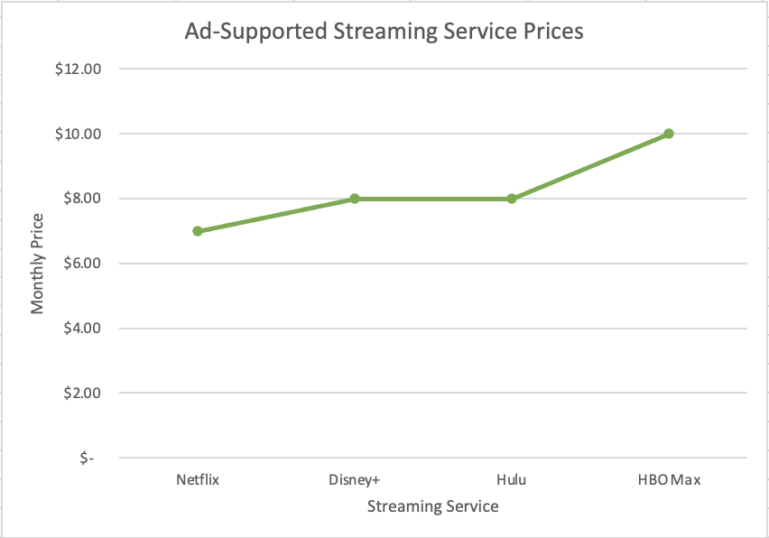
Acquiring Spotify could decrease subscription prices of Netflix which will expand their user base by allowing low-income households to afford Netflix
By taking advantage of ad-supported subscription plans, Netflix’s consumer base will grow into low-income communities.
Ad-supported Subscription Plans
On November 3, Netflix launched a new, ad-supported membership plan with a monthly price of $6.99. With one competitor, Hulu, having an ad-supported membership plan priced at $7.99, and Disney+ reportedly launching an ad-supported plan in December at the same price, Netflix will have a leg up on the competition with the lower price. Tammy Parker, principal analyst at GlobalData, was interviewed by Forbes about the new plan, and shared her thoughts in the following quote, “As the cost of living continues escalating, budget-conscious consumers seeking a less expensive Netflix tier will gladly accept ads intruding on their viewing experience in exchange for a lower monthly subscription cost” (Fitzgerald, 2022). This also gives way to people that, before, couldn’t afford the cost of Netflix to enjoy the thousands of titles that are available.
Branding
By using the new ad-supported plan to their advantage, Netflix could produce new, unique commercials that are focused not only on family, but inclusivity. With the acquisition of Spotify also comes their marketing team. One aspect of Spotify’s marketing strategy that they are known for is their emotional advertisements. Netflix, while advertising their new ad-supported plan, could use ideas from the Spotify team to put together a moving ad that draws people to the streaming service. One of Spotify’s most famous campaigns was the 2021 ’Only You’ campaign. "Only You was launched in June [2021] to celebrate odd listening habits. Spotify used the in-app experience of the users to make them stand out from the crowd,” (Gorbatch, 2021) By distributing messages in-app to its users, Spotify made it clear that they care about their subscribers. In the new era of co-branding, Netflix could use some of Spotify’s similar strategies to gain new subscribers.
Consumers love low prices. Not only are they easier to justify, but they are more accessible to a larger market of people. By combining low prices and heart-warming marketing tactics from Spotify’s repertoire, Netflix’s consumer base could increase to pre-2022 levels: before the sudden loss of over 1 million subscribers.

Slide 11
Combining Spotify and Netflix’s marketing teams will be seamless with their countless similarities
Using Spotify’s history of influencer and brand partnerships, Netflix can grow its commercial repertoire.
Both companies use personalized content making for a smooth transition for marketing departments
Combining departments as part of an acquisition can sometimes be difficult, if the two companies have previously two very different ways of working, or even two different ways of managing. Looking deeper into the marketing department, if the two companies have vastly different ways of advertising, their advertising teams are not going to mesh well once the acquisition is official. Luckily, Spotify and Netflix have similar marketing styles. Both companies use a lot of personalized content in their promotions. Netflix uses feedback from their servers to create a personalized experience while subscribers are using the service. They also collect information and create commercials based off which shows or movies are the most popular at the time (Arun, 2022). Spotify, in a similar fashion, collects information about it’s subscribers and uses it to make song recommendations and comes out with the infamous Spotify Wrapped at the end of the year. “It was a humble first effort, but it was very clear that people found this compelling,” says Alex Bodman, vice president and global executive creative director at Spotify. This “humble” first iteration began as “Year in Review” and has grown into visual appealing share cards flooding social media platforms that show an individual’s top songs, artists, genres, minutes spent listening, and more (Shalvoy, 2021). With all that being said, Spotify Wrapped is no more than an ad campaign. When subscribers get their “results” at the end of the year, a large portion of them share them to social media. In 2020, Wrapped results were shared over 60 million times, without counting screenshots (Shalvoy, 2021).
Spotify’s history of influencer and brand partnerships
Spotify has put their wide array of business connections to good use in the past. They have partnered with countless companies from Starbucks to Tiffany & Co. (Amin, 2022). Spotify then uses these connections to get their streaming service more potential subscribers by gaining more visibility through promotions. Spotify has also worked with many influencers in the past. By working with influencers, brand credibility is built in a rather short time. I think Spotify could bring these tactics to Netflix’s marketing team, and one the ideas are flowing, create an advertisement dream team.

Slide 12
Internal: Job Creation and Impact on Company Culture

Slide 13
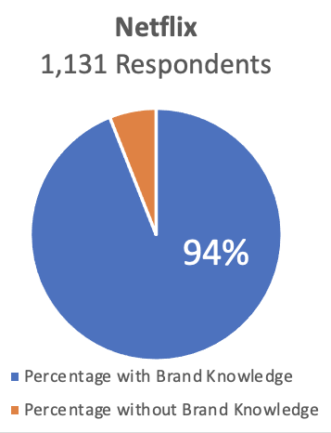
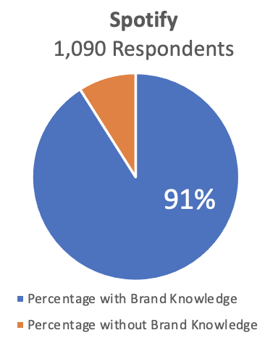
Spotify will help Netflix expand the streaming industry by the collaboration of both music and videos to widen their target audience which allows more job opportunities
Netflix acquiring Spotify will help deliver a wider variety of options to target more customers with music and videos, leading to industry expansion and a positive consumer experience.
Industry Presence
Netflix has been a lead streaming entertainment service company for 25 years.The company has a significant presence in the video streaming industry, taking up 47.1% of audience demand for digital originals worldwide (Stoll, 2022). This presence is essential as it helps draw attention to customers to engage in brand loyalty. In the U.S., over 94% of the 1,131 respondents were aware of Netflix and its brand (Kunst, 2022). Its company has earned its spot in the entertainment industry, showing an opportunity for reinvention to ensure an increase in earnings. Spotify also has a significant presence in the music streaming industry. Over 91% of the 1,090 respondents in the U.S. have an awareness of the company (Kunst, 2022). Its users possess brand recognition and loyalty, ensuring Spotify holds a critical market position. Combining these two powerful companies can lead to a larger presence in the market and broader customer demand, leading to more jobs, thus, industry expansion. Netflix acquiring Spotify will draw attention from both companies' large consumer bases to ensure the addition of subscribers is met.
Additional Employees Creating Experience
Netflix is a large company with around 11,300 employees, which is more than double its employees in 2016 (Stoll, 2022). This doubling employees can be explained as the demand and attraction for Netflix skyrocketed between the years 2017 and 2018. Spotify has around 6,617 employees, nearly half the number of employees that Netflix has (Götting, 2022). These numbers tell a story of how the companies can operate proficiently. When adding employees to a company, the goal is for the employee to carry out the mission that holds the company true to its values (Peek, 2022). Employees can create excellent customer experience and retention by providing great service skills. Acquiring Spotify will allow Netflix to build its employee positions, which in turn, will boost its customers experience and generate more revenue.
Notes:
Visual on this slide
Surprise its customers - Carry out the mission of the company – good customer experience and
https://www.business.com/articles/how-employees-make-or-break-business-success-and-how-you-can-lead-the-way/

Slide 14

Spotify will enable Netflix to create new job opportunities in the technology and content creation space through the expansion of music
Spotify’s diversified music industry can help Netflix build careers in the technology and content creation fields to gain more employees leading to an increase in employee retention.
Creation of Jobs
The addition of Spotify’s employees can help Netflix create new job opportunities that will allow them to reach its new target audience. When acquiring Spotify, Netflix is looking to add talent and expertise to the latest market it will be attracting. Adding music, podcasts, radios, and more can all create new positions for Netflix to establish. Content creation is vast in the social media age today, and without it, companies have a low chance of survival (Social Media for Business, 2022). An acquisition like this will attract lots of attention, needing employees to be persistent and present with advertisements and information for consumers to grab. Netflix can build many careers on new social media campaigning helping employees push its agenda for this acquisition.
Spotify and Netflix run most of its company online, other than the ability to download, but its technology presence must be adequate to keep customers satisfied. Technology management and support are immense for these two companies to survive. The addition of technical support will have to be put in place for an ensured smooth transition between the two companies. Software engineer and IT roles can be filled by opening positions to talented individuals that will create value. Companies must constantly look ahead to the future to survive against their competitors (Heltzel, 2019).
Spotify has an internship program for students in data analysis, marketing, technology, product management, and more. Its primary target audience gets the opportunity to see how the company functions (Spotify, 2022) internally. This opportunity could be huge for Netflix, as it could benefit from specific feedback to reach its younger audience that will foster its connection. By Netflix expanding its job opportunities in its market, they have to ability to offer a diverse range of new products to a new target audience. Netflix’s advantage to adding new jobs to help its company’s internal system is the ability to strengthen and bring meaning to that specific department.
Job Opportunities &
connections created
through Social Media

Slide 15
Netflix acquiring Spotify will positively impact company culture as fusing differing management styles can lead to a more diverse environment
Netflix's importance of diversity in company culture can be further pursued by the integration of Spotify's emphasis on heavy inclusivity in the workplace.
Management and Company Culture
Netflix encourages its employees to take risks and think big to keep up with the competitors around them (Nguyen, 2021). On a similar track, Spotify encourages a risk-friendly environment with hopes to keep its employees sharing their creative ideas. Its company runs several tests on each idea that is thought of to experiment with the unknown (Mankins & Garton, 2017). Both companies give heavy emphasis on creative freedom and testing to produce the best result for its customers. All employees must feel they can share creative ideas and speak freely in their environment of work and these two companies do that single handedly, but together can produce a workplace environment that thrives.
Diversity and Inclusion
Netflix's present pursuit of diversity in its company has been building since 2017 by casting individuals of different race, ethnicity, and backgrounds in their movies (Netflix, 2022). One its web page, it show resources for mental health, indigenous, trans, pride, etc. Community and belonging are two important themes within its company. Spotify's job page on its website leaves no trace for topics to be left uncovered with tabs to click on such as Mental Health, Diversity, Inclusion, & Belonging, Climate Action, Racial Equity, Social Impact (Spotify, 2022). The importance of these topics shows the compatibility the two companies have. This similarity can help the two companies provide a functional and respectful work environment to help them grow in the future.
Potential Challenges
M&As have the intention of boosting growth and developing competitive advantage for companies that have went through a revenue or subscriber decrease. A huge reason M&As fail is because corporate/company culture does not mix well together after the companies integrate (Picardo, 2022). The companies differing work styles and environments can have the potential to make it impossible to move forward. If problems of integration do occur, there are steps the company can take to fix a broken culture. A company can first find out what its team craves, access visibility within their culture, and make a cultural game plan (Comaford, 2018). While Spotify and Netflix's work ethic and company environment are similar, the potential for a clash is a possibility. Ensuring there is a plan for if their work environments dispute is how the companies can stay focused on its main goal, success.
Notes:
Visual on this slide

Slide 16
Spotify’s risk-friendly environment will accelerate Netflix’s employees’ development of content ideas multiplying productivity
Spotify’s unique management style can improve Netflix’s productivity with the increased presence of encouragement risks and trial runs
Spotify’s Work Environment
Netflix’s current management strategy can be described as well beyond adequate, but Spotify’s productivity skills can support its work environment. Spotify’s organizational environment is built on openness and trust. Two terms allow its teams to improve communication when collaborating to enhance mobile marketing (Moore, 2021). A team-orientated structure ensures communication is the top priority benefitting Netflix’s growing team structure. Spotify’s positive work environment also includes benefits in its employees’ lives with global parental leave, flexible public holidays, extensive learning opportunities, and more (Spotify, 2022). Employees are more likely to produce their best work at the company if they know they are being compensated for it. With a productive environment, employees can keep up with the moving world around them, allowing Netflix to follow its customers with futuristic ideas rather than chasing them to stay. The faster the ideas are tested and trail-ran, the faster Netflix can enter new markets, markets that have already been conquered by Spotify, such as music, podcasts, radio, and more.
Increasing Productivity
Based on Spotify’s employees, its core values are innovation, collaboration, sincerity, passion, and playfulness. All words contribute to a positive working environment where employees can thrive (Moore, 2021). Positive work environments combat negative energy, such as stress and procrastination, while boosting positive energy, such as confidence and decisiveness. Employees can bounce back from failure quickly to avoid wasted time (Seppälä & Cameron, 2015). Netflix’s increase in productivity allows them to expand its company to new horizons with the help of its focused employees. As a result, Netflix can build its efficiency to deliver goods and services faster to its customers, improving customer satisfaction. Customer satisfaction leads to increased customer retention and higher lifetime value, two crucial concepts Netflix is struggling to maintain.
Openness
Trust
Productive Work Environment

Slide 17
External: Creating Value for the Consumer

Slide 18
Acquiring Spotify furthers consumer personalization through algorithms that are customized to each individual and their past usage analytics
Spotify would benefit Netflix by allowing its consumers to have a more personalized experience through the utilization of data from analyzing consumer preferences.
Netflix and Spotify have unique features in personalization that allow them to satisfy the customer experience
Netflix currently offers its users features like recommended for you, which customizes show options based off what the individual has watched in the past. Netflix states that their algorithm adjusts, as an individual watches more and more shows, then it can find a show that someone may like based off past preferences. This is then compared to people with similar taste, and recommendations are made (Netflix Help Center). While this is a good system, it often gets repetitive. Many people are offered the same movies and shows every week, and if they did not click on them the first time they may not be interested in these films. Netflix also offers a Top 10 ranking of shows and movies for the week. These rankings are often biased to new films that gain popularity solely they have an uptick in viewers. Netflix has good personalization techniques, but they can increase consumer satisfaction further with technology that Spotify utilizes.
Spotify currently has many similar aspects to its music and podcast recommendations and rankings, but they have Discover Weekly which is very different than anything Netflix offers now. Their engineers that design their algorithms compare them to an individual's bookshelf within their own home. The bookshelf is customized by the individual to what their reading interest are, and they will add books based on these. The Spotify library is similar except it is digital, and their algorithm does the customizing for you (Spotify Engineering, 2020). Spotify Vice President of Personalization, Oskar Stal, stated that “over time, our engineers realized that ’you enjoy Spotify more if you discover more, and most people don’t have time to discover on their own’” (Spotify Newsroom, 2021). When it realized this, Spotify implemented an algorithm that personalizes its customers listening in an individualistic way that is varied week by week. This creates value for the consumer because of the personal touch that this experience has.
Implementing a combined personalization strategy optimizes user experiences
By acquiring Spotify, Netflix would have access to their engineers, and would be able to collaborate and design a similar algorithm that could be used for all the movie and show titles within their service. Another aspect that Netflix could tap into is Spotify “Wrapped”, this is an end of the year compilation of users most listened to artists, songs, albums, etc. This has been a huge hit, and even promotional effort that Spotify has implemented (Dodda, 2022). Spotify and Netflix engineers could come together to make a more personalized experience for Netflix users through Spotify’s algorithms, and it could even further push a feature like Spotify “Wrapped” onto Netflix with most watched shows of the year, and other forms of personal touch.
Spotify’s Advanced Personalization Process
Artists
Songs
Playlists
Listening Habits
Spotify Algorithm
Discover Weekly
Personal Playlists
Notes:
Will help Netflix personalize … etc

Slide 19
Utilizing Spotify’s extensive network of businesses leads to the creation of a diverse content and strategic partnerships.
Spotify is partnered with multiple large companies already, and by acquiring them, Netflix would gain access to these connections. This would allow for future expansion in content creation and partnerships enabling Netflix to be more accessible to a variety of consumers.
The connections that Spotify has increases consumer perception
Spotify has increased its partnership portfolio in order to grow within the music industry in the past few years. They have partnered with Peloton and Samsung, and many other companies in order to expand their brand. First, by partnering with Peloton they have been able to create a user experience that is unique to these members. In 2021, Spotify created multiple playlists that Peloton instructors could use during their workout videos. By doing this, Peloton got the music that is vital for working out, and Spotify expanding their consumer base into the realm of online cycling classes (Olson, 2021). The other big partnership that Spotify has recently put into place, was with Samsung. This allows Spotify to be compatible with all Samsung devices, and remain connected when switching between devices (Newsroom, 2022). Consumers that utilize Samsung devices gain a better experience when utilizing Spotify to listen to their favorite songs. By partnering with these two companies Spotify has expanded their name, and increased value in the mind of their consumer base.
Mergers and Acquisitions Direct Consumers To Purchase Their Service
Personal Consumer Alignment
Customer Perception of M&A
Impulse Buying
Purchase Intention
Brand Loyalty
(Putra et al., 2021)
Consumer value will increase through Netflix’s access to these companies
By acquiring Spotify, Netflix would gain access to its assets and portfolio of connections. Often, during acquisitions customer retention is lost because of an increase in customer uncertainty. In order to combat this, companies must show their customers that this acquisitions will be better for them through value creation (Hoffman, 2022). Netflix can ensure customers that this acquisition is worth it by pairing with the connections that Spotify has. Netflix could become a main source of entertainment on the Peloton bike entertainment display, and Samsung can have Netflix pre-programmed into their devices. Overall, this increases consumer value by providing Netflix in more locations and on more devices.
Notes:
What kind of businesses? – within the music industry
Strategic partnerships

Slide 20

Promotional opportunities increase from the addition of Spotify, leading to higher value in the minds of the consumer
The marketability of Netflix increases by acquiring Spotify because they can run promotions off each other in order to peak consumer interest.
Gaining more consumers through referrals
A powerful way of promotion is through a referral system. This is basically a free way of marketing, because the consumer passes a company's name onto their colleagues through word of mouth or a link. Netflix and Spotify could assist each other in an acquisition by having their consumers refer each other. This could even consist of a reward system per referral, as long as the company's reputation is good this allows for the ability to gain customers through existing subscribers (Francis, 2021).
New subscriber discounts create intrigue to purchase
Free trials or new user discounts must be used in the right context because if you offer a new user discount, but it only has limited access to “premium” features, the consumer believes they are not gaining the full experience they would be when paying. The point of the free trial in their eyes is to gain an insight and see if this product or service is worth their purchase (Reza, 2021). Utilizing this technique of marketing in the correct manner would generate consumer interest in a positive manner. Netflix and Spotify could use one another's subscriber bases to advertise the other streaming service. By connecting with these subscribers, the consumer is gaining access to a music and a movie/show streaming service. They are entertained, and the new acquisition is bringing in more revenue.
Mergers and acquisitions are a source of free advertising
Netflix acquiring Spotify would be two titans of their respected industries coming together and would be front page news. The publicity that would come from this acquisition would increase customer awareness of the streaming services, and gain value for the companies. Any advertising that includes these companies that is positive, is good advertising.
A Referral Program Efficiently Introduces New Consumers
Primary Consumer
Referral 1
Referral
Referral
Referral 2
Referral

Slide 21
Creating bundle packages with Spotify services generates consumer interest
By creating bundles between two companies within top performing industries consumers are more inclined to purchase considering many of their entertainment needs are met within one subscription.
Bundling Spotify and Netflix into one subscription provides opportunities for M&A success
Companies that utilize mergers and acquisitions to grow have success when they expand their scope by investing in complimentary products or services (Renneboog, 2019). The goal of bundling overall is to lower prices for consumers and create more value by pairing two or more products or services together. By doing this, a consumer is paying less for more and they tend to favor that. This also increases the likelihood that consumers subscribe because they have more wants and needs met in one purchase. Spotify and Netflix are two unlike companies, therefore they would compliment each other in a bundle by appealing to different service industries.
Another aspect that must be reached for Netflix to be satisfied bundling, according to Rand Incorporated is, the buyer must conduct research to determine whether the bundle is necessary in the mind of the consumer and justified by the resulting benefits the company would encounter (Baldwin, 2002). As stated before, this acquisition will bring in more revenue for Netflix, and bundling these two companies together as services will further appeal to the consumer base and be beneficial in terms of profit and increased consumption.
Bundling has worked for other companies, and can work for Netflix
As stated before, bundles are a successful way of lowering prices for the consumer but created more revenue for companies. One successful example of a service bundle is Disney+, Hulu, and ESPN+. This bundle combines two popular streaming services for movies and shows, along with the most popular provider for sports in ESPN. This bundle creates value for the consumer through the diverse services and different categories that they are in. This bundle was able to be created because all these services are owned by Disney, and President Bob Iger saw value in combining all of these services into one subscription.
Netflix could do this by acquiring Spotify and creating a peace of mind bundle. This allows consumers to know that they are getting the best of both services in a bundle (Shankar, 2009). With the service bundle of Netflix and Spotify they would be getting the leader in movie and tv streaming and the leader in music and podcast streaming all in one. This creates value and differentiates from what competitors have to offer.
(Nielsen, 2022)

Slide 22
External: Impacts of an Acquisition on Target Market
Notes:
Expand to another area from assignment sheet

Slide 23
Spotify's more diverse and global user demographic will expand Netflix's consumer base
Spotify's subscribers will be a huge addition to Netflix's already large target market, using its unique gender and age demographics to widen the consumer base.
Age and Gender Demographics
Acquiring Spotify would mean acquiring Spotify's subscribers as well. This is a huge positive aspect. Spotify has over 188 million subscribers which will widen Netflix's target market in many ways. Netflix's female subscribers dominate the male subscribers by just 4%, however Spotify is a different story. Spotify's male subscribers account for 56% of their listeners as of Q2 2022 (Singh, 2022). The acquisition will help Netflix gain more appreciation from Spotify's male audience and vice versa. As for age, 29% of Spotify's users are in between the ages of 25 and 34 (Iqbal, 2022). Netflix, however, has 29% of their subscribers in the age range of 35-54 (Dixon, 2021). This difference will be a very positive aspect of the acquisition. With Spotify's subscribers being exposed to Netflix's services, the target market will widen, therefore growing Netflix's consumer base to the younger generation.
Globalization
While over one third of Netflix's subscribers are in the United States and Canada, the same proportion of Spotify's subscribers are in Europe. With the acquisition, the numbers for music streaming could go up in the United States and Canada, and the same for video streaming for Europe. This cross exposure will in turn expand the company's overall target market.
New Content Opportunities
Consumers want new content. In a survey conducted by GoodFirms, "34.3% of those surveyed choose streaming services based on the accessibility of fresh content" (MarTech, 2022). The one thing Netflix does is online video streaming. With the addition of Spotify and all their services, Netflix will be able to attract a whole new set of consumers. Spotify not only has music but also podcasts and even audiobooks. With the co-branding, Spotify's services will be exposed to a whole new market. Not only opening the market with convenience, but also spreading the word of globalization of both music and video streaming.
SPOTIFY
Between Ages 25 – 34, mostly male
NETFLIX
Between Ages 35 – 54, mostly female
Notes:
Visual- percentage of subscribers – specify where that Is

Slide 24
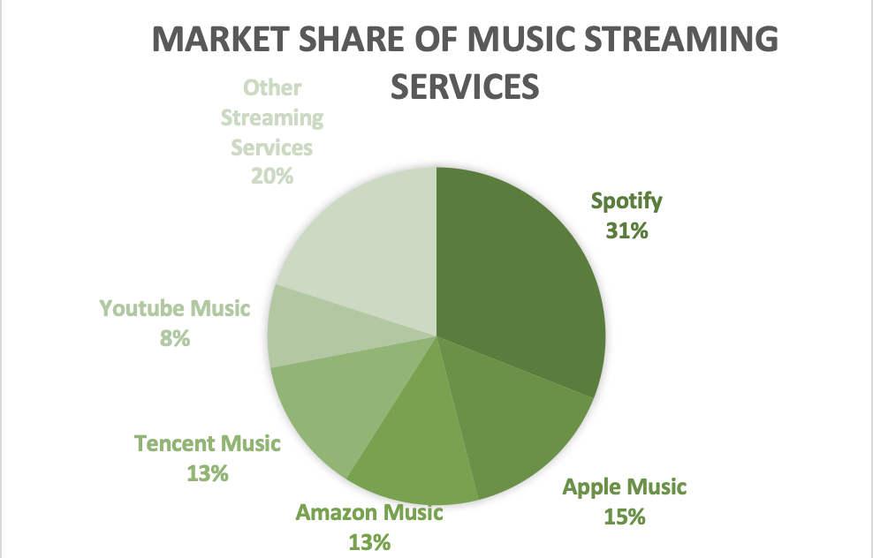
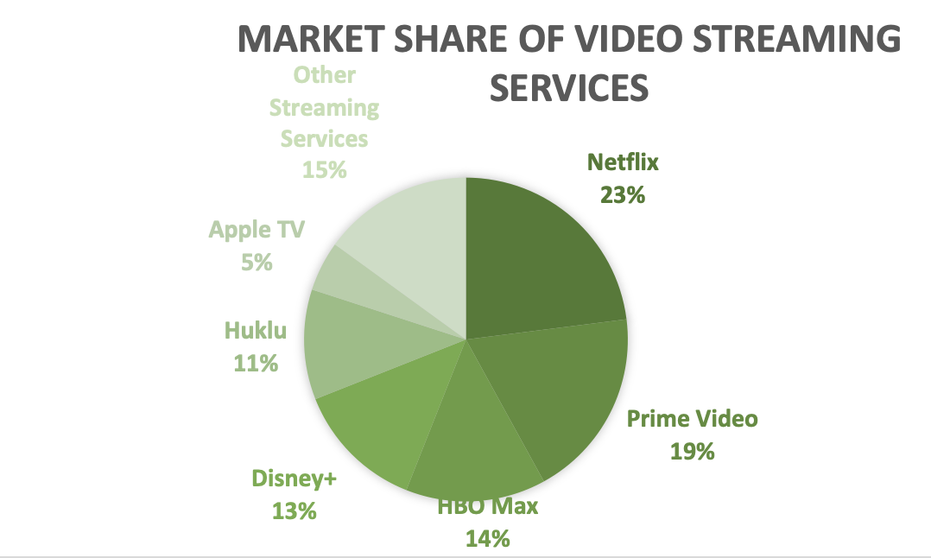
Netflix co-branding with Spotify will lower market competition by combining the two most popular streaming services in their respective industries
With Netflix dominating the online video streaming industry and Spotify being the most popular music streaming platform, uniting the two companies will lower market competition in both industries.
Online Video Streaming and Music Streaming
Online video streaming started in 1998 when iTV launched out of Hong Kong, China. "Launching the service would require over 1.5 billion dollars" (van der Craats, 2022). While the founders of iTV had started in 1998, it wasn't until 2005 when YouTube was created that online video streaming really became popular. Once it was obvious that online video streaming was going to be popular, it didn't take long for the market to become flooded with competition. Netflix rose to the top in 2011 and has stayed there ever since. Netflix currently has control over 23% of the market as of Q1 2022 (Forristal & Perez, 2022). Since the start in 1993, online music streaming has been popular. While there isn't quite as much competition in the music streaming industry, it is still a very large business, and accounted for over $25 billion in revenue in 2021 (Curry, 2022). Spotify "is currently the most popular global audio streaming service, with around 31% market share globally in terms of subscribers" (Ramos, 2021). With over 11 million creators on the platform, everyone is bound to find something to like. In 2015, Spotify added podcasts to its app and has continued to grow immensely ever since.
Co-branding
Netflix acquiring Spotify will lead to lower market competition in both the video streaming industry and the music streaming industry. As both companies are the lead in their respective industries, competitors will have a hard time keeping up with the opportunities that the Netflix and Spotify co-branding will create. Along with the addition of Spotify's market share, the company will have control over a large portion over the online streaming world. After successfully completing the acquisition, Netflix could look to the future at more acquisition opportunities or even mergers to take the entertainment industry to a whole new level. Consumers are shown to be supportive of firms engaging in M&A activities and believe that it ultimately benefits the customer as well. The modern consumer understands that companies acquire firms to expand and increase profit margins (Kestenbaum, 2019).
Notes:
Line graph about spotifys growth
Focusing is confusing – switch to combining?
Wait for grader comments

Slide 25
Conclusion
The acquisition of Spotify will positively impact Netflix internally
Acquiring Spotify will diversify the media portfolio of Netflix by branching out from movies and shows to then adding music, podcasts, and even audio books. From here, it will be able to ensure a consistent revenue stream, and hedge against an economic downturn in either industry. Netflix can then focus on producing content and bringing in more movies and shows instead of taking more off their platform. Another affect within the organization that will occur from this acquisition is a shift in company structure for employees and executives, while creating more job opportunities. Expanding into new industries allows for creative content to flourish, and more divisions in the company to open. Merging work cultures for Netflix and Spotify would allow for a more diverse company and more job opportunities.
Spotify allows Netflix to create consumer value and decrease market competition
Externally, the addition of Spotify increases consumer value through personalization and promotional efforts. With the recent decline in consumer subscriptions Netflix is looking to increase consumer value. Spotify allows Netflix to expand its consumer personalization through user-based algorithms. It will also have access to Spotify’s vast business portfolio, allowing it Netflix to expand its connections with companies. Additionally, acquiring Spotify allows for an increase in promotional and bundling opportunities. Successful mergers and acquisitions create more value for the consumer, and that is what Spotify allows for. On top of promotions, Spotify allows Netflix to expand its consumer demographics including different ages, genders, and cultures. Outside of the consumer, market competition would decrease because this acquisition would bring together two of the largest streaming services in the music and entertainment industry. Content creation and co-branding would increase extensively.
Netflix acquiring Spotify allows for content creation focusing on trends in movie and music production
Netflix is known for its video creation and Spotify is known for its collaborations with music artists. Bringing these two things together results in endless possibilities for the future. Artists have been creating more music videos for their songs and albums, Netflix and Spotify creation teams could come together to produce these music videos for artists. A trend that has recently came about is movies and shows referencing the 1900’s. Spotify can assist Netflix with the creation of this content by offering soundtracks from these decades. Bringing together these two industry leaders ensures content creation that will appeal to consumers in the future.
Notes:
- What will happen as a result of implementing your recommendation?
- present and future
- mid range impacts, next steps, and possible future goals
- external and internal outcomes
- restate previous claims from slides
- SAS headers from exec summary
Section 1: Impact: what is the affect within the organization in present time?
Section 2: Reflection: effect of outside organization in present time
Section 3: Future: effect outside organization in future time
- 3 separate paragraphs with SAS headers

Slide 26
Attributions
Ellie: Slides 5-8
Olivia: Slides 13-16
Kyle: Slides 18-21
Kaitie: Slides 10, 11, 23, 24

Slide 27
References
Amin, Z. (2022, July 8). 9 Spotify Marketing Strategies You should definitely try. Squeeze Growth. Retrieved November 4, 2022, from https://squeezegrowth.com/spotify-marketing-strategies/
Arun, R. (2022, September 13). A case study on Netflix marketing strategy: Simplilearn. Simplilearn.com. Retrieved November 4, 2022, from https://www.simplilearn.com/tutorials/marketing-case-studies-tutorial/netflix-marketing-strategy
Ashish. (2022, September 1). Spotify's in-stream advertising: An untapped marketing opportunity. Growth Marketing Genie. Retrieved November 6, 2022, from https://growthmarketinggenie.com/blog/spotify-advertising-opportunities/
August 16, 2022. (2022, August 16). Spotify and Samsung's partnership gives users more ways to listen. Spotify. Retrieved November 6, 2022, from https://newsroom.spotify.com/2022-08-16/spotify-and-samsungs-partnership-gives-users-more-ways-to-listen/
Baldwin, L. H., Camm, F., & Moore, N. Y. (2002, January 1). Bundled services: A framework for cutting costs, improving performance, and supporting small businesses. RAND Corporation. Retrieved October 26, 2022, from https://www.rand.org/pubs/research_briefs/RB89.html
“Being Here: Life at Spotify.” Being Here | Life at Spotify, Spotify, 2022, https://www.lifeatspotify.com/being-here.
Bhargava, V. (2022, September 20). Spotify social media marketing strategy: How Spotify uses social media listening to stay on top of the game. Radarr. Retrieved October 22, 2022, from https://www.radarr.com/blog/spotify-social-media-marketing-strategy/
Brewer, J. (2021). A visual identity designed to spark joy: Behind the scenes of Spotify Design's new look. It's Nice That. Retrieved October 22, 2022, from https://www.itsnicethat.com/articles/spotify-design-graphic-design-sponsored-content-290121
Comaford, Christine. “Three Steps to Fix a Broken Culture.” Forbes, Forbes Magazine, 12 May 2018, https://www.forbes.com/sites/christinecomaford/2018/05/12/three-steps-to-fix-a-broken-culture/?sh=58b0ad5442f0.
Curry, D. (2022, September 12). Music Streaming App Revenue and Usage Statistics (2022). Business of Apps. Retrieved October 24, 2022, from https://www.businessofapps.com/data/music-streaming-market/
Davis, B. (2022, September 19). Spotify competitors analysis: Who stacks up against this music streaming service? The Stock Dork Stock Ideas, Penny Stocks, Product Reviews. Retrieved October 22, 2022, from https://www.thestockdork.com/spotify-competitors-and-alternatives/
Digital Resource. (2021). The growing popularity of podcasts: Why start One in 2022. RSS. Retrieved October 21, 2022, from https://www.yourdigitalresource.com/post/why-you-should-start-a-podcast-in-2022

Slide 28
References
“Diversity, Inclusion & Belonging: Life at Spotify.” Diversity, Inclusion & Belonging | Life at Spotify, Spotify , 2022, https://www.lifeatspotify.com/diversity-equity- impact/diversity-inclusion-belonging.
Dixon, C. (2021, August 23). User demographics for netflix, disney+, tubi, and YouTube. nScreenMedia. Retrieved October 25, 2022, from https://nscreenmedia.com/streaming-user-demographics-top-4-services/
Dodda, R. (2022, April 21). Council post: Driving growth for media streaming apps: Personalization is the way. Forbes. Retrieved October 26, 2022, from https://www.forbes.com/sites/forbesbusinesscouncil/2022/04/20/driving-growth-for-media-streaming-apps-personalization-is-the-way/?sh=1755fd0e489a
Elkins, E. (2018, December 6). Algorithmic cosmopolitanism: On the global claims of Digital Entertainment platforms. Taylor & Francis. Retrieved November 6, 2022, from https://www.tandfonline.com/doi/abs/10.1080/15295036.2019.1630743?journalCode=rcsm20
Fitzgerald, T. (2022, October 17). Will people flock to Netflix's new ad-supported service? experts weigh in. Forbes. Retrieved November 6, 2022, from https://www.forbes.com/sites/tonifitzgerald/2022/10/14/will-people-flock-to-netflixs-new-ad-supported-service-experts-weigh- in/?sh=4bfac4157aa3
Forristal, L., & Perez, S. (2022, April 19). Netflix shares down more than 20% after losing 200,000 subscribers in first quarter. TechCrunch. Retrieved October 25, 2022, from https://techcrunch.com/2022/04/19/netflix-shares-down-more-than-20-after-losing-200000-subscribers-in-first-quarter/
Francis, G. (2021, May 14). 5 powerful service marketing strategies for success. LinkedIn. Retrieved November 6, 2022, from https://www.linkedin.com/pulse/5- powerful-service-marketing-strategies-success-geoffrey-francis
Geyser, W. (2022, August 22). Advertising on Spotify - the ultimate guide to spotify advertising. Influencer Marketing Hub. Retrieved November 6, 2022, from https://influencermarketinghub.com/advertising-on-spotify/amp/
Gorbatch, A. (2021, October 12). Spotify the masters of marketing: 6 campaigns for Inspiration. Awario Blog. Retrieved November 5, 2022, from https://awario.com/blog/spotify-the-masters-of-marketing-campaigns/
Götting, Marie Charlotte. “Topic: Music Streaming.” Statista, Statista , 20 June 2022, https://www.statista.com/topics/6408/music- streaming/#dossierContents__outerWrapper.
Heltzel, Paul, and Contributing writer. “12 Ways It Can Create Business Value in 2019.” CIO, Foundry, 8 Apr. 2019, https://www.cio.com/article/219937/12- ways-it-can-create-business-value-in-2019.html.
Hoffman, M. (2022, May 23). Council post: Maximizing Growth Through Acquisitions. Forbes. Retrieved November 6, 2022, from https://www.forbes.com/sites/forbesbusinesscouncil/2022/05/20/maximizing-growth-through-acquisitions/?sh=175132de3a7d

Slide 29
References
“How Netflix Reinvented HR.” Harvard Business Review, Harvard Business Publishing, 31 Aug. 2022, https://hbr.org/2014/01/how-netflix-reinvented-hr.
How netflix's recommendations System Works. Help Center. (n.d.). Retrieved October 24, 2022, from https://help.netflix.com/en/node/100639
“Inclusion & Diversity .” Netflix Jobs, Netflix , https://jobs.netflix.com/inclusion.
Iqbal, M. (2022, September 6). Spotify revenue and Usage Statistics (2022). Business of Apps. Retrieved October 25, 2022, from https://www.businessofapps.com/data/spotify-statistics/
Kadar, I. (2017, July 21). Streaming services find success in International Markets. >> globalEDGE Blog. Retrieved November 6, 2022, from https://globaledge.msu.edu/blog/postamp/53441/streaming-services-find-success-in-inter
Kahlert, H. (2021, November 24). Lean out is in: How the Netflix / Spotify crossover is taking advantage of a key consumer dynamic. MIDiA Research. Retrieved October 21, 2022, from https://midiaresearch.com/blog/lean-out-is-in-how-the-netflix-spotify-crossover-is-taking-advantage-of-a-key-consumer-dynamic
Kestenbaum, R. (2019, May 28). What consumers think about mergers and acquisitions. Forbes. Retrieved October 24, 2022, from https://www.forbes.com/sites/richardkestenbaum/2019/05/28/what-consumers-think-about-mergers-acquisitions/?sh=425c4ab66926
Krajewski, L. (2022, May 2). Learn about Spotify's customer retention and CX. SharpenCX. Retrieved November 6, 2022, from https://sharpencx.com/blog/spotify-customer-retention/
Kunst , Amanda. “The University of Iowa Libraries.” Off Campus Access - The University of Iowa Libraries, 18 Oct. 2022, https://www-statista- com/forecasts/1328344/spotify-digital-music-brand-profile-in-the-united-states.
Lin, Y. (2021). How many people listen to podcasts worldwide? (2019–2024). Oberlo. Retrieved October 21, 2022, from https://www.oberlo.com/statistics/how-many- people-listen-to-podcasts Music Business Worldwide. (2021, October 27). Six reasons why regionality still matters for the global music streaming business. Music Business Worldwide. Retrieved November 6, 2022, from https://www.musicbusinessworldwide.com/six-reasons-why-regionality-still-matters-for- the-global-music-streaming-business/
Nguyen, Tien Viet. “Inside Netflix Company Culture: Amazing and Unusual.” Grove HR Solution, 2022, https://blog.grovehr.com/netflix-company- culture#:~:text=Freedom%20and%20Responsibility,to%20make%20the%20best%20decision.
Olson, C. A. (2021, November 3). Peloton and Spotify pump up their partnership. Forbes. Retrieved November 6, 2022, from https://www.forbes.com/sites/cathyolson/2021/11/03/peloto-and-spotify-pump-up-their-partnership/?sh=38b58ee66f7f

Slide 30
References
Patel, Kison. “Acquisition as a Growth Strategy - High-Growth Approach (2023).” RSS, DealRoom, 1 Nov. 2022, https://dealroom.net/blog/mergers-and- acquisitions- as-a-business-growth-strategy.
Picardo, Elvis. “How M&A Can Affect a Company.” Investopedia, Investopedia, 13 July 2022, https://www.investopedia.com/articles/investing/102914/how- mergers-and-acquisitions-can-affect-company.asp.
“Proof That Positive Work Cultures Are More Productive.” Harvard Business Review, Harvard Business Publishing, 8 May 2017, https://hbr.org/2015/12/proof-that-positive-work-cultures-are-more-productive.
Pusztai, H.-M. (2020, June 30). Why brands are turning to Spotify as the next big social platform. Buffer Resources. Retrieved November 6, 2022, from https://buffer.com/resources/spotify/amp/
Putra, I. F., Windasari, N. A., Hindrawati, G., & Belgiawan, P. F. (2021, December 3). Is two always better than one? customer perception on the merger of Startup Decacorn Companies. MDPI. Retrieved November 10, 2022, from https://doi.org/10.3390/joitmc7040239
Ramos, M. V. (2021, December 17). Listening to the future: Podcasts and emerging markets sustain spotify´s leadership. RUN. Retrieved October 15, 2022, from https://run.unl.pt/handle/10362/140501?locale=en
Renneboog, L., & Vansteenkiste, C. (2019, July 26). Failure and success in mergers and acquisitions. Journal of Corporate Finance. Retrieved October 26, 2022, from https://www.sciencedirect.com/science/article/pii/S0929119918303298
Reza, S., Calvert, G., Shi, H., Ling, R., & Ho, D. (2021, January 7). Don't count on free trials to win you customers. Harvard Business Review. Retrieved November 6, 2022, from https://hbr.org/2021/01/dont-count-on-free-trials-to-win-you-customers
Roseman, Adam. “The Case for Hiring More Full-Time Workers.” Harvard Business Review, Harvard Business Publishing, 16 July 2019, https://hbr.org/2019/07/the-case-for-hiring-more-full-time-workers.
Shalvoy, J. (2021, December 21). Spotify unwrapped: Inside the company's biggest marketing campaign. Variety. Retrieved November 6, 2022, from https://variety.com/2021/music/news/spotify-wrapped-marketing-shares-1235139981/
Shankar, V., Berry, L. L., & Dotzel, T. (2014, August 1). A practical guide to combining products and services. Harvard Business Review. Retrieved October 26, 2022, from https://hbr.org/2009/11/a-practical-guide-to-combining-products-and-services
Singh, P. (2022, October 3). 30+ spotify statistics, Facts and Trends to know in 2022. Appinventiv. Retrieved October 25, 2022, from https://appinventiv.com/blog/spotify-statistics-facts/

Slide 31
References
“Social Media for Business.” Support for Businesses in Australia, Australian Government , 2 May 2022, https://business.gov.au/online/social-media-for- business.
Spotify Engineering. (2022, January 27). For your ears only: Personalizing spotify home with Machine Learning. Spotify Engineering. Retrieved October 26, 2022, from https://engineering.atspotify.com/2020/01/for-your-ears-only-personalizing-spotify-home-with-machine-learning/
Spotify Newsroom. (2021, October 28). Adding that extra 'you' to your discovery: Oskar Stål, Spotify vice president of Personalization, explains how it works. Spotify. Retrieved October 26, 2022, from https://newsroom.spotify.com/2021-10-13/adding-that-extra-you-to-your-discovery-oskar-stal-spotify-vice-president-of- personalization-explains-how-it-works/
Stoll, J. (2022, October 14). Svod Service user shares in the U.S. 2022. Statista. Retrieved October 26, 2022, from https://www.statista.com/statistics/318778/subscription-based-video- streamingservicesusageusa/#:~:text=According%20to%20the%20most%20recent,most%20U.S.%20subscribers)%20is%20Netflix.
Stoll, Julia. “Netflix: Number of Subscribers Worldwide 2022.” Statista, Statista , 19 Oct. 2022, https://www.statista.com/statistics/250934/quarterly-number-of-netflix- streaming-subscribers-worldwide/.
Stoll, Julia. “The University of Iowa Libraries.” Off Campus Access - The University of Iowa Libraries, Statista , 27 July 2022, https://www-statista-com /statistics/587671/netflix-employees/.
“Students: Life at Spotify.” Students | Life at Spotify, Spotify , 2022, https://www.lifeatspotify.com/students.
Tateossian, T. (2022, February 3). What does the future of podcasting look like? top podcasting trends for 2022. RSS. Retrieved October 21, 2022, from https://www.bcast.fm/blog/future-of-podcasting
van der Craats , M. (2022, August 1). VOD via the internet in 1998? Divitel. Retrieved October 24, 2022, from https://divitel.com/news/vod-via-the-internet-in-
1998/
What's old is new again: Bundles could help consumers cope with increasing streaming service choice. Nielsen. (2022, July 22). Retrieved November 11, 2022, from https://www.nielsen.com/insights/2022/whats-old-is-new-again-bundles-could-help-consumers-cope-with-increasing-streaming- service- choice/
Writer, M. T. S. S. (2022, April 19). Netflix and Spotify dominate the online streaming industry. MarTech Series. Retrieved October 25, 2022, from https://martechseries.com/technology/netflix-and-spotify-dominate-the-online-streaming-industry-goodfirms-survey-report-2022/

